Slide 1

r/smarthome

Slide 2


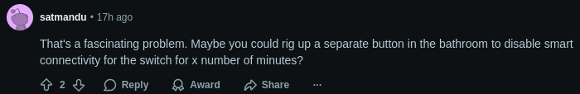
Bathroom Smart Lights - "So you're a bad parent, also, that's stupid."
https://www.reddit.com/r/smarthome/comments/1oq0ak3/smart_light_switches_for_bathroom_that_are_teen/

Slide 3
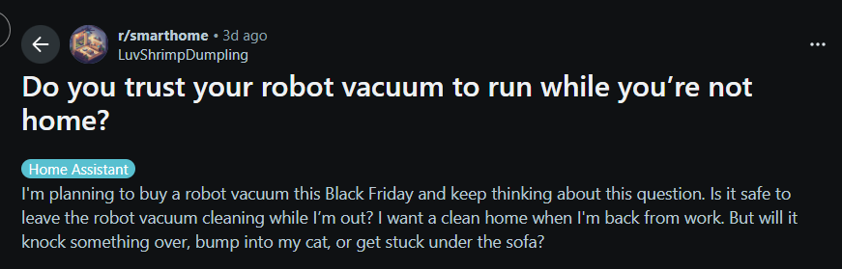
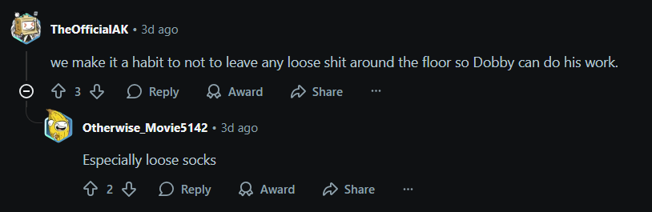
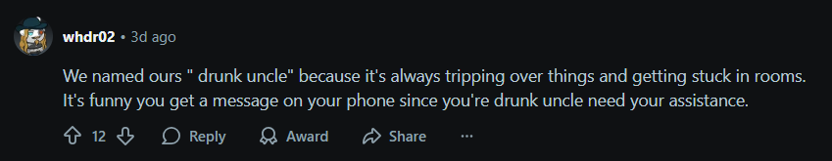
Anthropomorphising robot vacuums

Slide 4
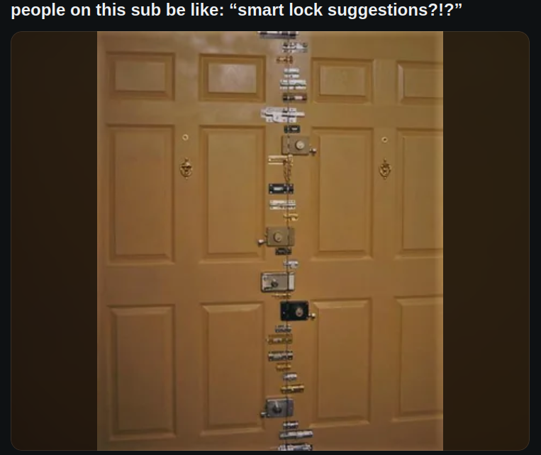
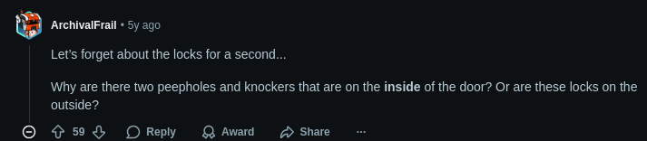
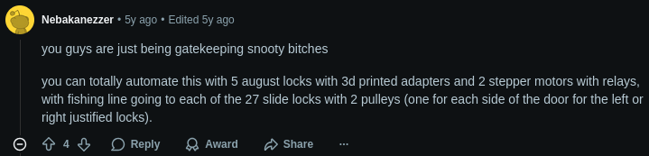
Inside Jokes – self aware?
https://www.reddit.com/r/smarthome/comments/h0runx/people_on_this_sub_be_like_smart_lock_suggestions/

